Slide 1

Technology in media
MoVIE : The machine
By
Shravya mahankali

Slide 2
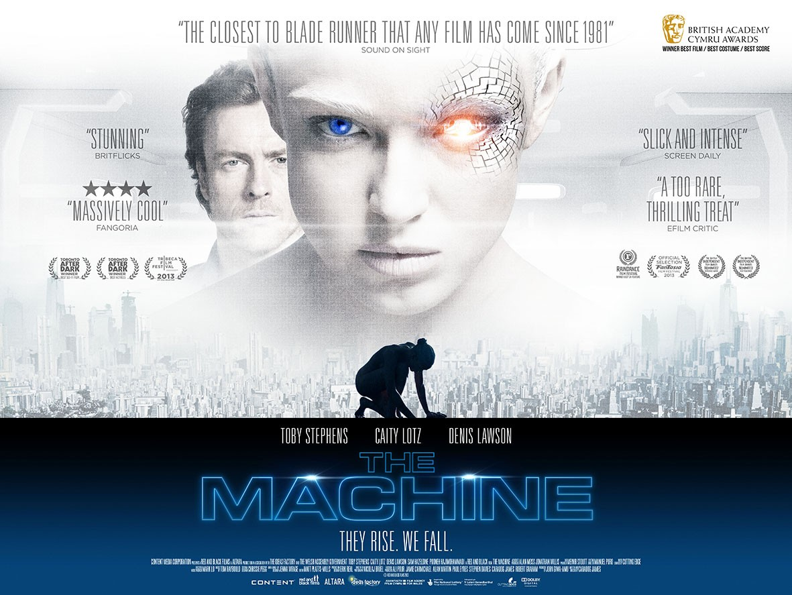
The machine

Slide 3
The machine : introduction
This Movie Is A British Science Fiction Thriller Movie Written And Directed By Caradog W.James.
In This Movie Scientists Create An Artificial Intelligence For The Military.

Slide 4
Movie Plot : The machine
The Britain’s Ministry of Defence employs Computer Scientists to produce Artificial Intelligent Soldiers who were previously injured in the war.
They aim at producing a perfect robot weapon to battle against China in a new Cold war rather than nuclear weapons.
They produce a cybernetic implant that makes brain-damaged soldiers to gain back its lost functions by inserting into human bodies.

Slide 5
CONT..
These cyborgs don’t have the capability for human speech but they develop a highly efficient method of communication.
With the help of a new junior scientist they could produce a new Machine that is self aware and conscious android.
And this human turns out to be more human than they have wanted or expected.

Slide 6
CONT…
This story depicts how this man made Machine who is programmed to kill, saves its Creator’s life when a human can’t protect himself.

Slide 7
Issues addressed
This movie gives back life to the people who were injured in the war.
It depicts how an artificial intelligent robot can make a good decision using laws of morality rather than the instructions it gets like a human do.
The film tells that if a robot is programmed with the moral laws and ethics initially, it cannot do against the situation even if it is instructed to cause any harm.

Slide 8
Cont…
The robot which was programmed with the laws or morality regrets when accidentally killed a person to protect herself.
The machines refuses any orders from anyone that violates the sense of morality.
It talks more about humanity rather than technology.

Slide 9
Cont…
This movie finds how can a robot can think like a human by not only passing the turing test but also handling difficult situations.
It makes scientist understand that they should not relate their personal life to their work life.
It depicts how a robot can validate between the order that is passed by its owner and the right thing to do.

Slide 10
View of the director
The director wants to portrait the advantages of the robots in military and how the military is going to be replaced by robots instead of humans.
This film shows how artificial intelligence technology is going to bring a new era in the technology field.
The director wants to show people how an artificial intelligent robot can think like a human and tackle the difficult situations.

Slide 11
Cont…
With this movie the director wants to educate the people how military can be modernized and soldiers can be produced using artificial intelligence.
The director also points out how the injured soldiers in the military can be cured and get back to their lives.
The director wants to portrait the positive side of the technology.

Slide 12
CONT…
This movie educates the people regarding the good decision skills of the robot.
The director even shows how the robots will strive for the truth regardless of turning against its owner.
The director portraits the robot as a human both in appearance and in actions.

Slide 13
Personal opinion on author’s view
I do agree with the author that military can be replaced by the artificial intelligent robots.
I also agree with the point that there is a possibility for the evolution of robots where we cannot find any difference between robots and humans both in appearance and analyzing situations.

Slide 14
Cont…
Artificial Intelligence can be developed to incorporate the moral laws and ethics into robots.
I do agree with the point that injured soldiers should be treated and they should be presented with the earlier life using all the advancements in the artificial technologies.

Slide 15
Cont…
I do agree with the author that the technology can be used properly without interference of a human if its designed or programmed from all the corners in the beginning itself.
However, I vaguely disagree with robot killing a human accidentally.

Slide 16
Thank you…

